Slide 1
Lexical Analysis I
Specifying Tokens
Lecture 2
CS 4318/5531 Spring 2010
Apan Qasem
Texas State University
*some slides adopted from Cooper and Torczon

Slide 2
Review
Compiler Phases
  Front End
    Scanning
    Parsing
    Semantic Analysis
  IR
  Back End
    Semantic Analysis
    Instruction Selection
    Register Allocation
    Instruction Scheduling
  Middle End
    Optimizations
  Run-time system

Slide 3
The Front End
Source
Scanner
tokens
Parser
IR
code
Errors
The scanner reads the input program as a stream of characters and produces a sequence of tokens as output
  Only phase that comes in direct contact with the original user file
  All later phases sees some form of IR
Also known as
  tokenizer (because it produces tokens)
  lexical analyzer (most appropriate, describes true functionality)

Slide 4
Lexical Analysis
int main() {
int i;
for (i = 0; i < MAX; i++)
printf(“Hello World”);
}
Description of
Tokens in the
language
stream of characters
Scanner
<KEYWORD,int> <ID,main> <OP,(> <OP,)> <OP,{> <KEYWORD,int> <ID, i>
<SEP,;> <KEYWORD, for> <OP,(> <ID,i> <OP,=> <CONST,0> <SEP,;>
<ID,i><ID,MAX> <SEP,;> <ID,i> <OP,++> <ID,printf> <OP,(> <OP,“>
<STR, Hello World> <OP,”> <OP,)> <SEP,;><OP,{>
sequence of tokens
Notes:
Syntax error slide
Lexical error
Multiple instances of the input
MAX ? Printf?

Slide 5
Lexical Analysis
Does not have to be an individual phase. But having a separate phase
  simplifies the design and improves efficiency
  allows automation
  improves portability
We will look at both mathematical tools and programming techniques for lexical analysis
A good example of application of theory to practice

Slide 6
Lexical Analysis Issues
Two issues in lexical analysis:
  How to specify tokens in the language?
      Needs to be done manually
      Have good tools available
      English analogy: describe what a verb looks like, what a noun looks like …
  How to recognize the tokens given a token specification and an input program?
      Can be fully automated : lex
      English analogy: in a sentence, identify the parts of speech

Slide 7
Specifying Tokens
int main() {
int i;
for (i = 0; i < MAX; i++) {
printf(“Hello World”);
}
}
What are some tokens in the above C code fragment?
  all the basic elements in a language must be tokens so that they can be recognized

Slide 8
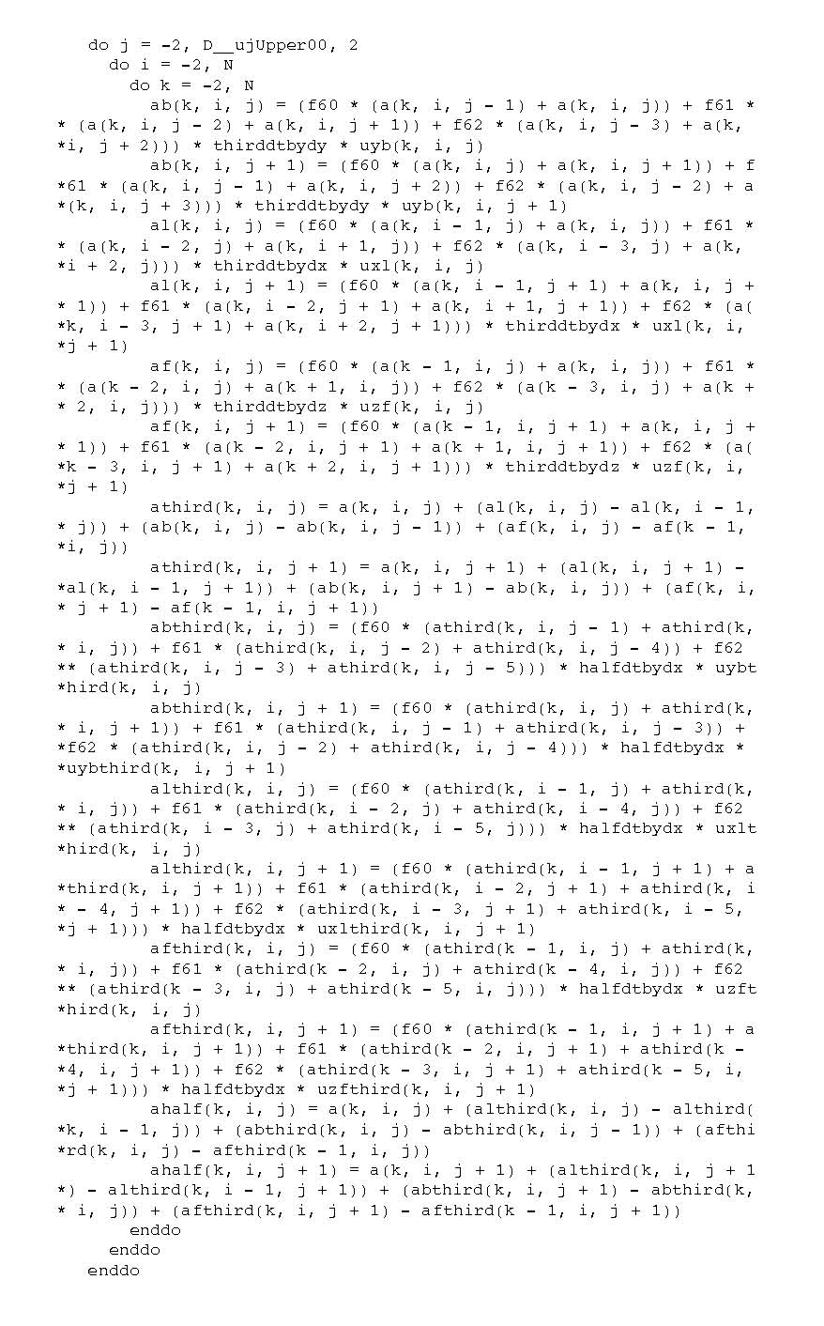

Same as the previous slide!
Number of different types of tokens doesn’t grow with program size

Slide 9
Tokens for C
What type of tokens do we need for C?
  Keywords
    May want to classify individual keywords
      e.g., KEYWORD_IF, KEYWORD_ELSE
  Operators
    May want to classify individual operators
      e.g., OPERATOR_PLUS, OPERATOR_ASSIGNMENT
  Literals
    May want to further classify literals
      e.g., LITERAL_STR, LITERAL_CHAR
  Identifiers
  Comments
    Eliminate comments at this phase

Slide 10
Specifying Tokens : Simple Approach
The simplest method of specifying tokens is to use the dictionary approach
Exhaustive list, a unique pattern for each possible word
  int for int
  { for { … and so on
  main for main
Can use this approach for English, but may run into some problems
  This is an oil painting.
  He wanted some oil for his bicycle.
  He wanted to oil his bicycle.
Problems
  Works OK, for keywords and operators, falls through for identifiers and literals - hugely inefficient!
  Enforces some restriction on language specification
    Size of identifier names
    Size of constants
Need a way to specify patterns
    Want to express infinite sets in a finite way

Slide 11
Specifying Tokens : Using Patterns
One way to describe the characters that form the keyword int
  i followed by n followed by t
  i AND n AND t
One way to describe all keywords in C
  int OR float OR double OR char … OR return
One way to describe an integer literal
  0 OR any digit REPEATED k times

Slide 12
Specifying Tokens Using Patterns
To specify patterns for all valid tokens in a programming language in a concise and efficient way, we want the following capabilities
  specify alternate patterns (OR)
  combine multiple patterns (AND)
  express repetition (REPEAT)
Regular Expressions give us exactly these capabilities!

Slide 13
Regular Expressions
A set of notations that can express the operations of alternation, concatenation and closure over symbols in an alphabet
REs have their origins in formal language theory
  REs were around before we started writing compilers
  Restricted form of REs used in unix commands grep, sed, ls etc.

Slide 14
RE Terminology
REs are defined over a particular alphabet
  An alphabet is a finite set of symbols
    e.g, {a-z, A-Z, 0-9}
REs describe a set of strings on the alphabet
  A string is any sequence of symbols from the alphabet
    e.g., abc, 09abc
  A set of strings over an alphabet is a language
    e.g., L = {set of all strings that start with ab}
    L = {ab, aba, abb, abc, …}
    Alphabets are finite, languages can be infinite
Languages described by REs are called regular languages
  innermost circle in the Chomsky hierarchy
  set of tokens for a programming language forms a regular language
    Not all syntax features can be captured by RE

Slide 15
RE Notation
Similar to set notation, applies specifically to sets of characters
  Set Operations
    Union
      L U M = {s | s is in L OR s is in M}
    Intersection
      L ∧ M = {s | s is in L AND s is in M}
    Concatenation of L and M (makes sense for sets of chars only)
      LM = {st | s is in L and t is in M}
    Closure L* = L⁰ + L¹ + L²+….
      L⁰ = {e}, L¹ = L, L² = L L, L³ = L² L
  REs
    Union (OR) : r | s denotes L(r) U L(s)
    Concatenation : rs denotes L(r)L(s)
    Closure: r* is an RE denotes L(r)*

Slide 16
Regular Expression
Given an alphabet ,
  is a regular expression that denotes { }, the set that contains the empty string
    included to make the math sound
  For each , a is a regular expression denoting {a}, the set containing the string a.
    e.g., RE = b
    L(RE) = {b}
    can use this to express languages that have only one string of length one

Slide 17
Regular Expressions
If r and s are REs denoting the sets L(r) and L(s)
  r | s is an RE denoting L(r) U L(s)
    e.g., RE = a | b
    L(RE) = {a, b}
  rs is an RE denoting L(r)L(s)
    e.g., RE = ab
    L(RE) = {ab}
  r* is an RE denoting L(r)*
    e.g., RE = a*
    L(RE) = {a, aa, aaa, aaaa, …}
L(RE) = { , a, aa, aaa, aaaa, …}
Need to include empty string

Slide 18
Precedence and Associativity
  ‘*’ has the highest precedence and is left associative.
  Concatenation has second highest precedence and is left associative
  Union has the lowest precedence and is left associative
    (a) | ((b)*(c ) ) = a | b*c

Slide 19
RL to RE : Examples
Assume alphabet ∑ = {0, 1}
All strings over the alphabet
  (0 | 1)*
  Rules: 2, 3, 5
All strings that start with 0
  0 (0 | 1)*
  Rules : 2, 3, 4, 5
All strings that contain three consecutive 1s
  (0 | 1)* 111 (0 | 1)*
  Rules : 2, 3, 4, 5

Slide 20
RL to RE
REs have to
  generate all strings in the language
  generate only the strings in the language
Implications
  accept only valid tokens
  reject all invalid tokens

Slide 21
RE to RL
(1* ( |01|001)1*)* ( |0|00)
  the language of all strings of 1s and 0s that does not contain three consecutive 0s
For this class we will go the other direction
  Examine the language and come up with REs for different tokens

Slide 22
REs for Keywords
How do we specify a regular expression for int?
Want to look for
  a pattern of i followed by n followed by t
RE = int
L(RE) = {int}
What rules do we apply?
  2 and 4
Similarly,
  float, double, char, if, else, for

Slide 23
REs for Operators
How do we specify an RE for the equality operator in C?
How many strings does the RL for the equality operator have?
RE = ==
L(RE) = {==}
What rules do we apply?
  2 and 4
Similarly
  =, <, >, <=, >=, +, -
  < and <= is not a problem if we have separate REs

Slide 24
REs for Integer Constants
digits = 0|1|2|3|4|5|6|7|8|9
(digits)*
0 | ((1|2|3|4|5|6|7|8|9)(digit)*)
(+|-|e) (0 | ((1|2|3|4|5|6|7|8|9)(digit)*))

Slide 25
Other REs Other Tokens
Identifiers, Strings and Comments are tricky
  Part of assignment 1

Slide 26
Example : Identifier
Assign names to regular expressions to construct more complicated regular expressions.
  example:
    letter -> A | B | C | … | Z | a | b | …. | z
    digit -> 0 | 1 | 2 | 3 | 4 | 5 | 6 | 7 | 8 | 9
    identifier -> letter (letter | digit) *

Slide 27
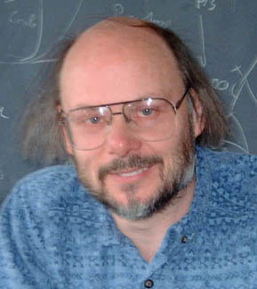


int main() {
int i;
for (i = 0; i < MAX; i++)
printf(“Hello World”);
}
lex
RE
scanner
tokens
The Big Picture
……

